Slide 1
Consensus - Paxos
Lecturer: Ngo Huy Bien
Software Engineering Department
Faculty of Information Technology
VNUHCM - University of Science
Ho Chi Minh City, Vietnam
nhbien@fit.hcmus.edu.vn

Slide 2

Objectives
To implement the Paxos protocol.

Slide 3

Contents

Slide 4

References
John Ousterhout and Diego Ongaro (2013) Slides. Implementing Replicated Logs with Paxos.
Leslie Lamport (2001). Paxos Made Simple.

Slide 5
Paxos Components
Proposers:
Active: put forth particular values to be chosen.
Handle client requests.
Acceptors:
Passive: respond to messages from proposers.
Responses represent votes that form consensus.
Store chosen value, state of the decision process.
Want to know which value was chosen.
Learners:
Receives information about chosen value.
For this presentation:
Each Paxos server contains any components.

Slide 6
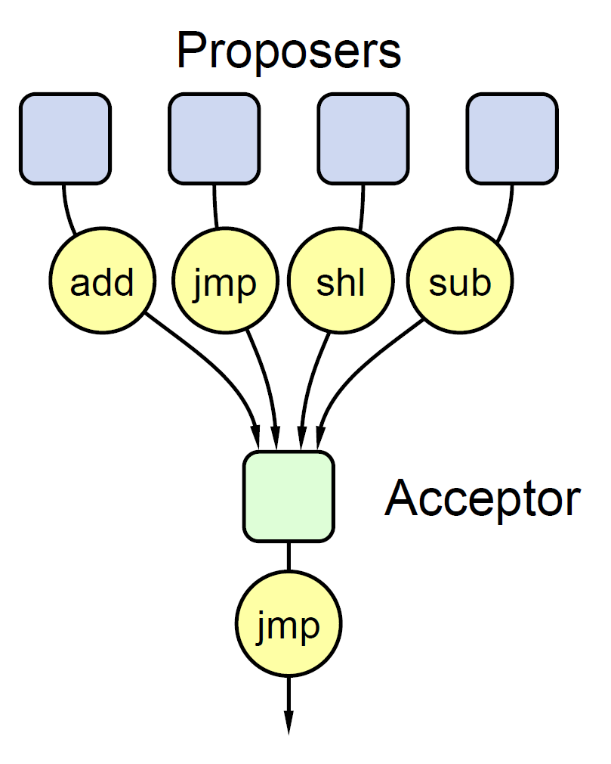
Strawman: Single Acceptor
Simple (incorrect) approach: a single acceptor chooses value
What if acceptor crashes after choosing?
Solution: quorum
Multiple acceptors (3, 5, ...)
Value v is chosen if accepted by majority of acceptors.
If one acceptor crashes, chosen value still available.

Slide 7
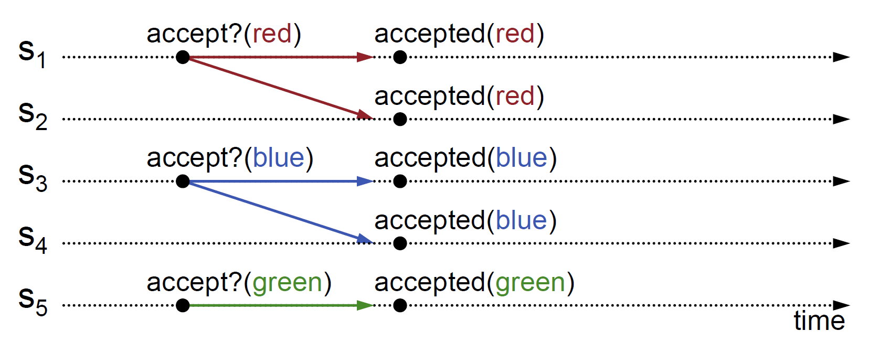
Acceptor accepts only first value it receives?
If simultaneous proposals, no value might be chosen .

Slide 8
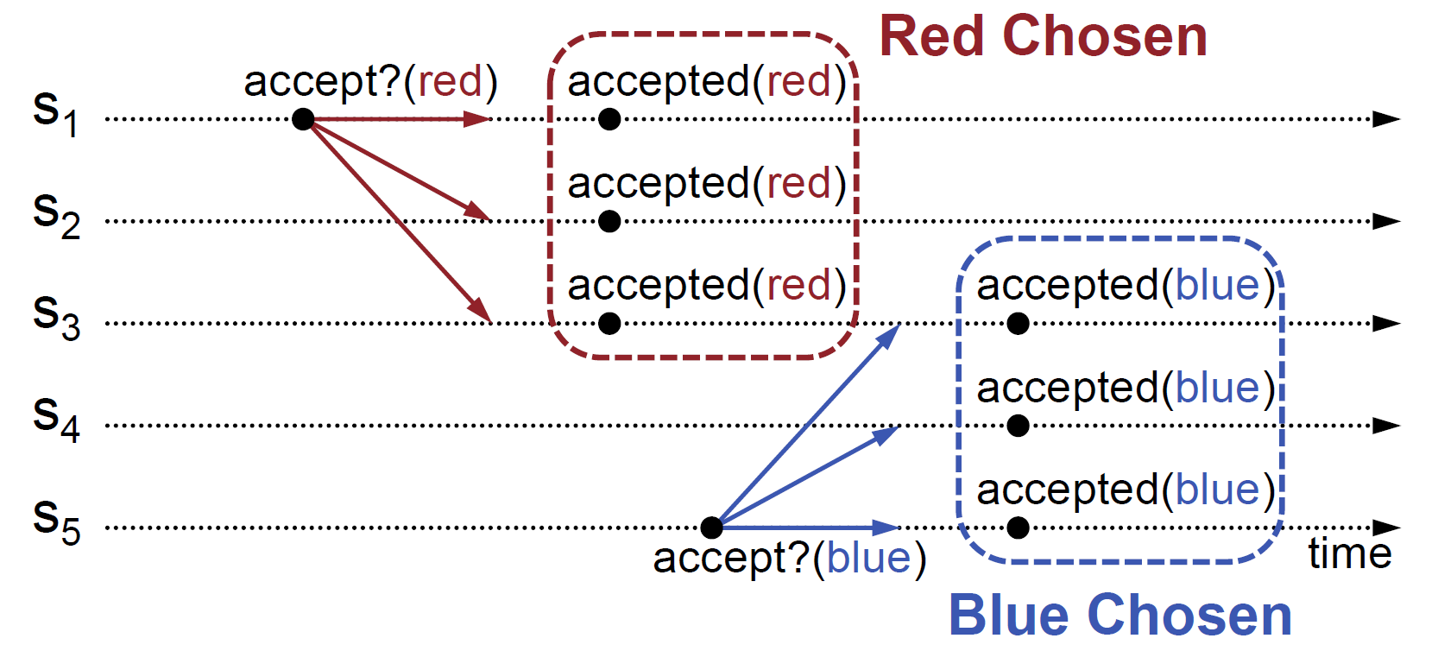
Acceptor accepts every value it receives?
Multiple values (both red and blue) may be chosen.

Slide 9
Idea: 2-Phase protocol is needed
Acceptors can accept multiple values.
But once a value has been chosen, future proposals must propose/choose that same value.
A 2-phase protocol is needed. S₃ must tell S₅ to accept red instead of blue.

Slide 10
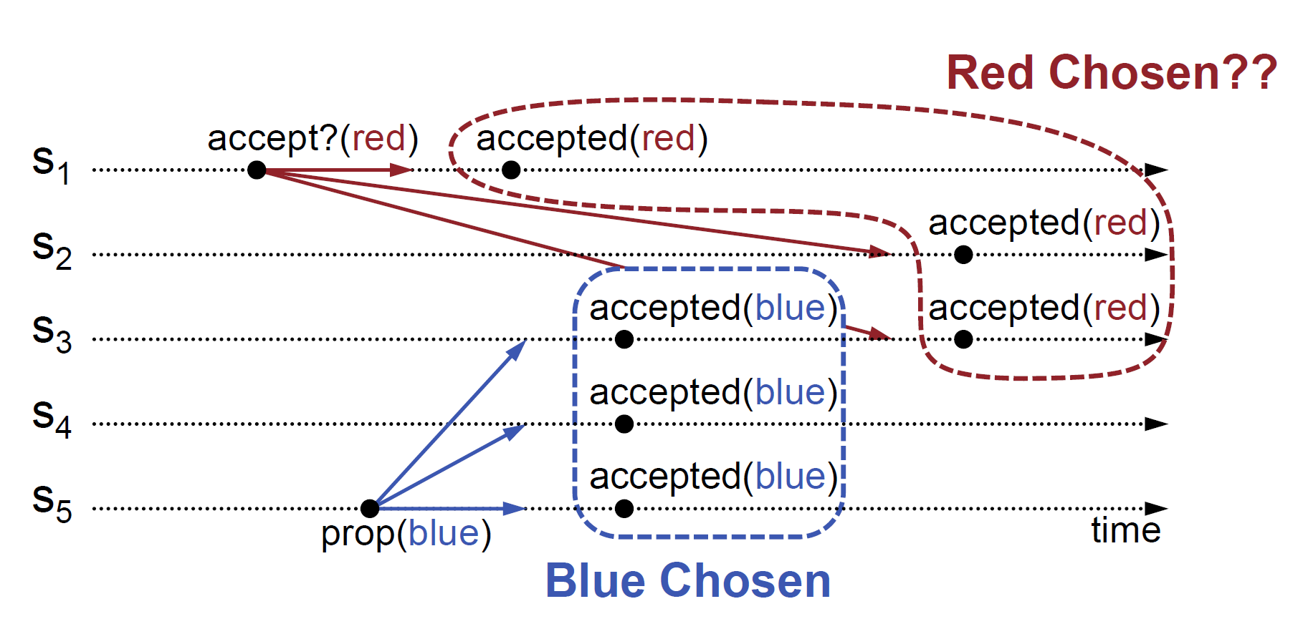
Idea: Proposal numbers are necessary
S₃ must reject red because blue was chosen.
Proposals must be ordered. Old ones that have not been accepted, must be rejected.
Proposal numbers are necessary.

Slide 11
Proposal Numbers
Each proposal has a unique number
Higher numbers take priority over lower numbers.
It must be possible for a proposer to choose a new proposal number higher than anything it has seen/used before.
Proposal Number: [Max Round].[Server Id]
To generate a new proposal number:
Increment [Max Round], then
Concatenate with Server Id.

Slide 12
Example Proposal Numbers
S1: Max Round = 0, ID = 1.
S2: Max Round = 0, ID = 2.
S3: Max Round = 0, ID = 3.
S1 generates a proposal number: S1P₁ = 1.1.
S1 generates next proposal number: S1P₂ = 2.1.
S2 generates a proposal number: S2P₁ = 1.2.
S3 generates a proposal number: S3P₁ = 1.3.
S1 sends S1P₁ to S2. S1P₁ < S2P₁.
S1 sends S1P₂ to S3. S1P₁ > S3P₁.

Slide 13
Basic Paxos
Two-phase approach:
Phase 1: broadcast Prepare RPCs
Find out about any chosen values.
Block older proposals that have not yet completed.
Phase 2: broadcast Accept RPCs
Ask acceptors to accept a specific value.

Slide 14
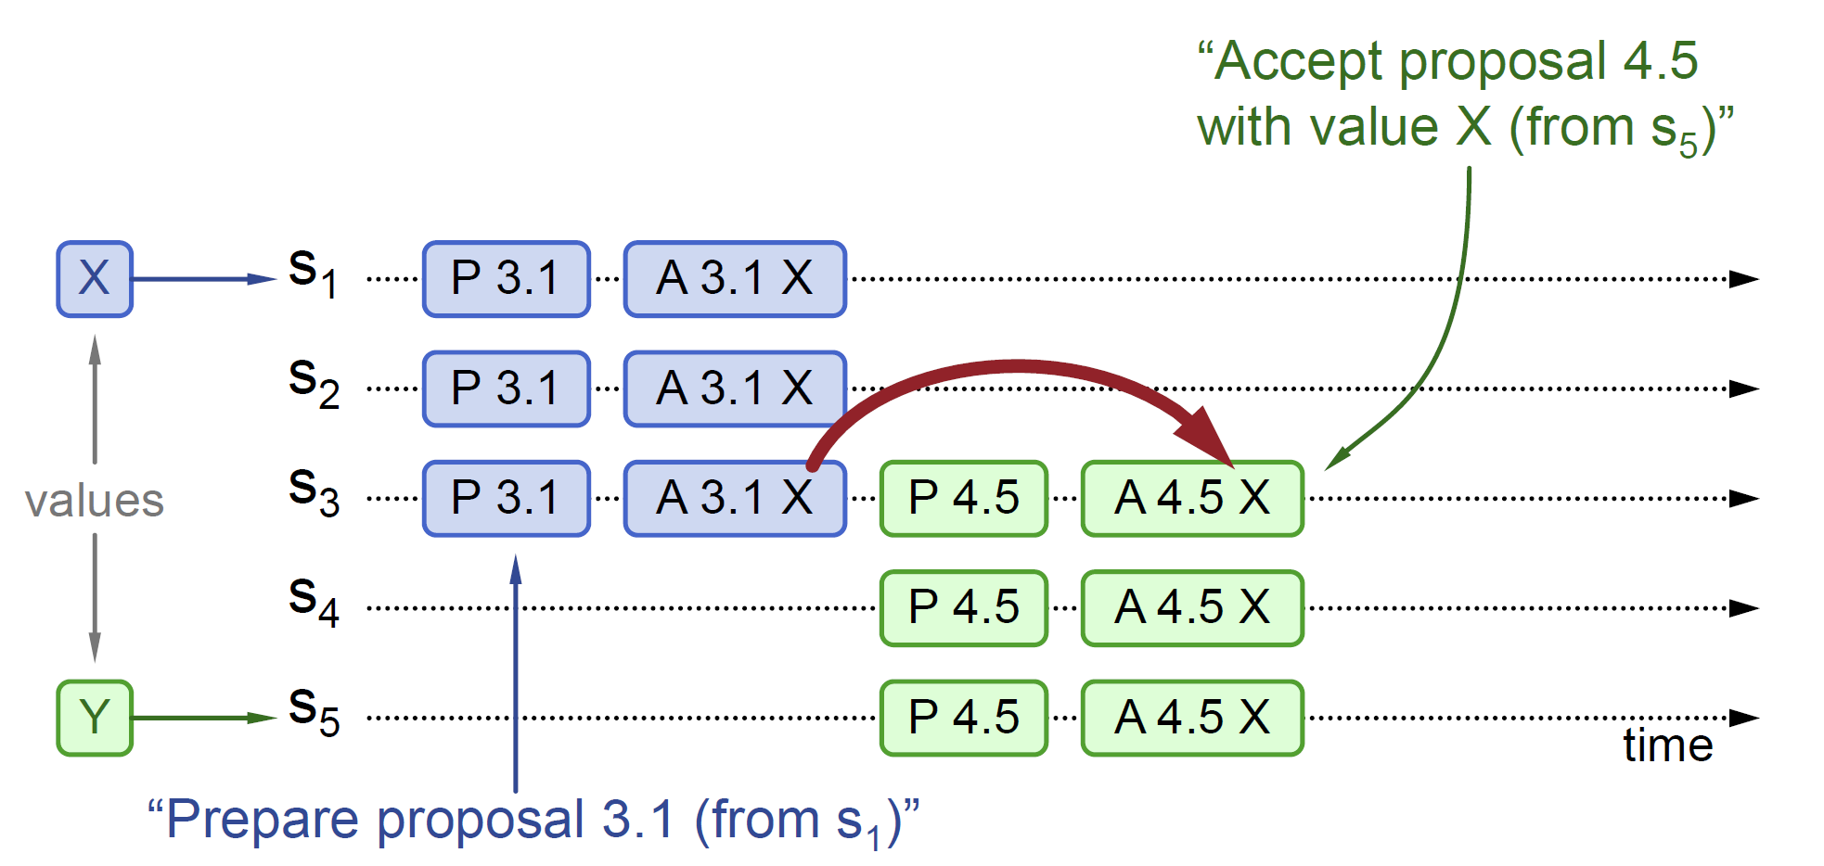
Example 1: Prepare (n)
A proposer chooses a new proposal number n and sends a request to each member of some set of acceptors.
S1 (max round++ = 3) sends P 3.1 to S1, S2, and S3.
S5 (max round++ = 4) sends P 4.5 to S5, S4, and S3.

Slide 15
Prepare (n) = ok/no, highest-numbered proposal and accepted value (if any)
If an acceptor receives a prepare request with number n greater than that of any prepare request to which it has already responded, then it responds to the request with a promise not to accept any more proposals numbered less than n and with the highest-numbered proposal (if any) that it has accepted.
S2 stores 3.1, returns ok, null, null to S1. S3 stores 3.1, returns ok, null, null to S1.
S4 stores 4.5, returns ok, null, null to S5. S3 stores 4.5, returns ok, 3.1, X to S5.

Slide 16
Accept (n, v)
If the proposer receives a response to its prepare requests (numbered n) from a majority of acceptors, then it sends an accept request to each of those acceptors for a proposal numbered n with a value v, where v is the value of the highest-numbered proposal among the responses, or is any value if the responses reported no proposals.
S1 sends A 3.1 X to S1, S2, and S3.
S5 sends A 4.5 X to S3, S4, and S5 because it received prepare response: ok, 3.1, X, from S3.

Slide 17
Accept (n, v) = ok/no and highest proposal number
If an acceptor receives an accept request for a proposal numbered n, it accepts the proposal unless it has already responded to a prepare request having a number greater than n.
S2 and S3 return ok, 3.1 to S1 because they has not responded to any prepare request having a number greater than 3.1.
S3 and S4 return ok, 4.5 to S5 because they has not responded to any prepare request having a number greater than 4.5. Notes: All subsequent P/A requests will accept X. With basic Paxos, after the consensus is reached, the value X will never change.

Slide 18


Slide 19
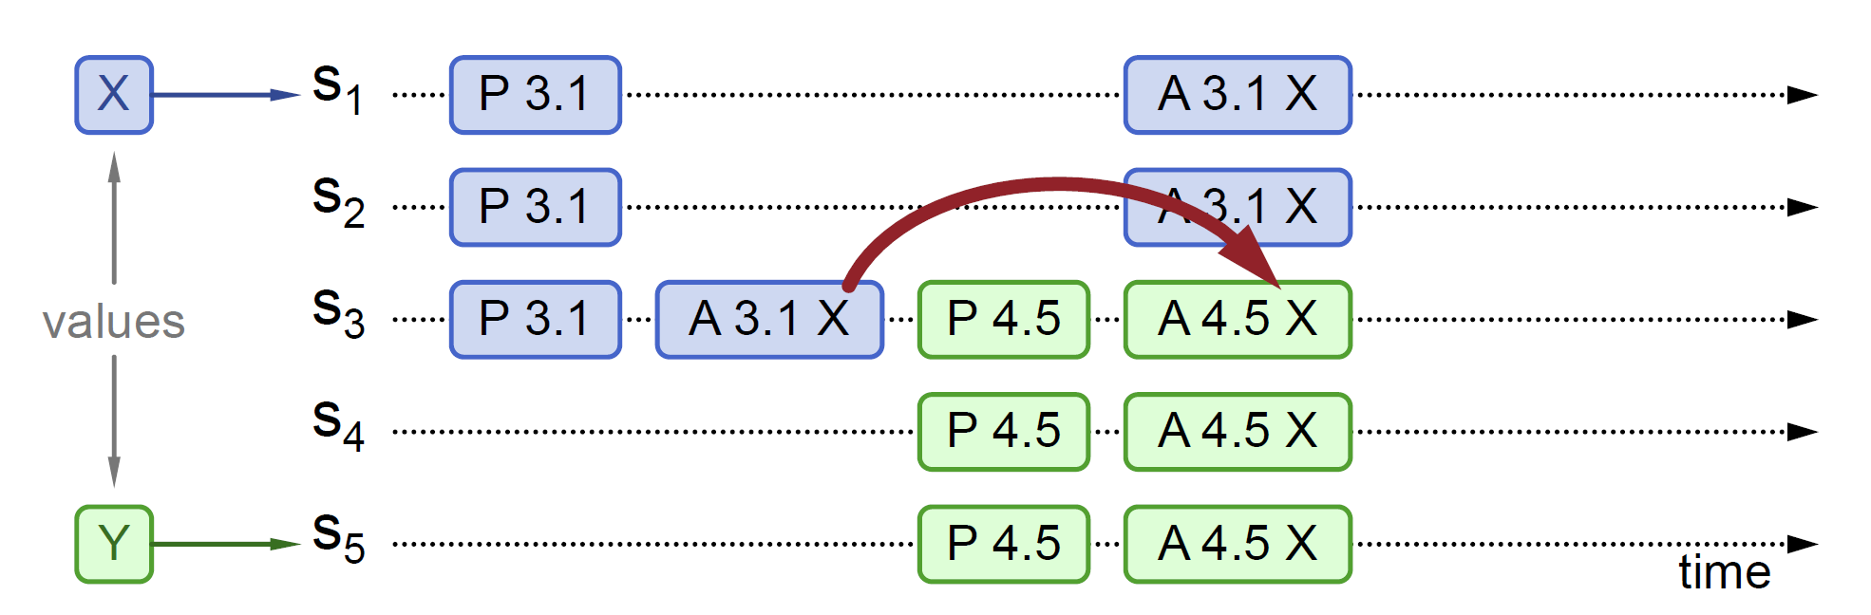
Example 2: Prepare (n)
A proposer chooses a new proposal number n and sends a request to each member of some set of acceptors.
S1 sends P 3.1 to S1, S2, and S3.
S5 sends P 4.5 to S5, S4, and S3.

Slide 20
Prepare (n) = ok/no, highest-numbered proposal and accepted value (if any)
If an acceptor receives a prepare request with number n greater than that of any prepare request to which it has already responded, then it responds to the request with a promise not to accept any more proposals numbered less than n and with the highest-numbered proposal (if any) that it has accepted.
S2 stores 3.1, returns ok, null, null to S1. S3 stores 3.1, returns ok, null, null to S1.
S4 stores 4.5, returns ok, null, null to S5. S3 stores 4.5, returns ok, 3.1, X to S5.

Slide 21
Accept (n, v)
If the proposer receives a response to its prepare requests (numbered n) from a majority of acceptors, then it sends an accept request to each of those acceptors for a proposal numbered n with a value v, where v is the value of the highest-numbered proposal among the responses, or is any value if the responses reported no proposals.
S1 sends A 3.1 X to S1, S2, and S3.
S5 sends A 4.5 X to S3, S4, and S5.

Slide 22
Accept (n, v) = ok/no and highest proposal number
If an acceptor receives an accept request for a proposal numbered n, it accepts the proposal unless it has already responded to a prepare request having a number greater than n.
S2 and S3 return ok, 3.1 to S1 because they has not responded to any prepare request having a number greater than 3.1.
S4 and S3 return ok, 4.5 to S5 because they has not responded to any prepare request having a number greater than 4.5.

Slide 24
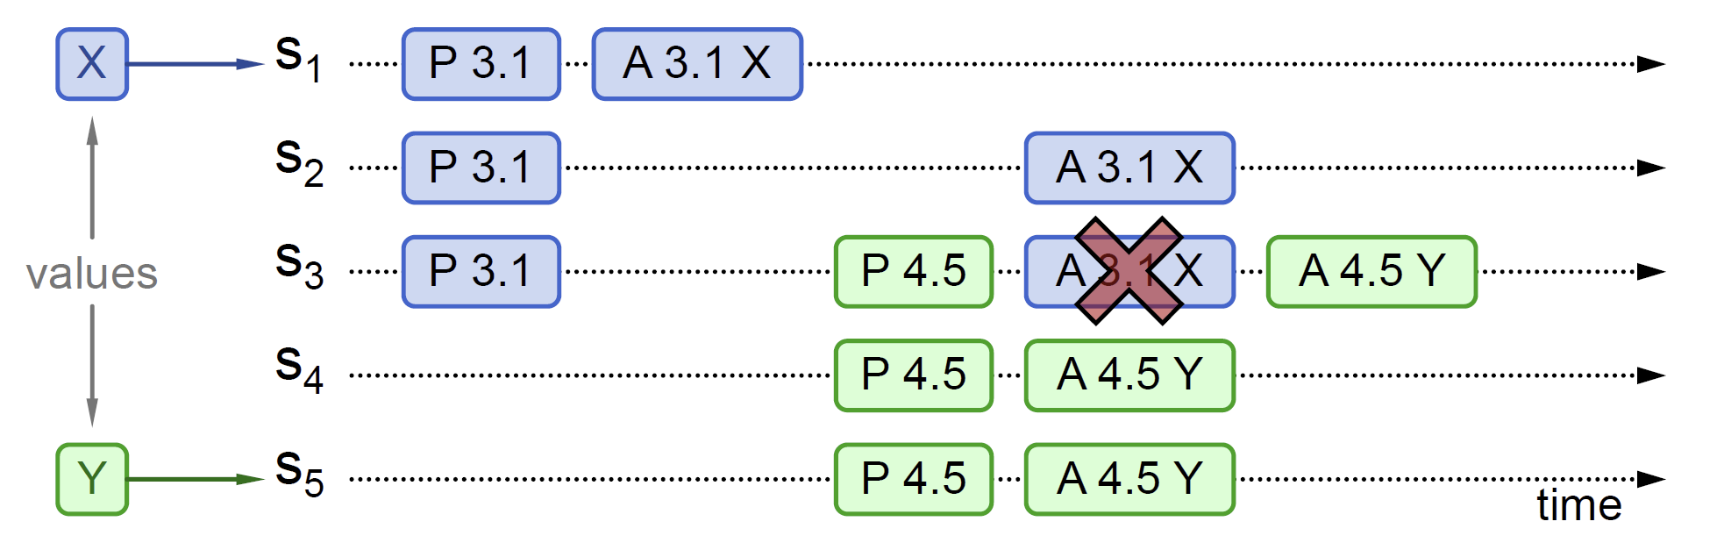
Example 3: Prepare (n)
A proposer chooses a new proposal number n and sends a request to each member of some set of acceptors.
S1 sends P 3.1 to S1, S2, and S3.
S5 sends P 4.5 to S5, S4, and S3.

Slide 25
Prepare (n) = ok/no, highest-numbered proposal and accepted value (if any)
If an acceptor receives a prepare request with number n greater than that of any prepare request to which it has already responded, then it responds to the request with a promise not to accept any more proposals numbered less than n and with the highest-numbered proposal (if any) that it has accepted.
S2 stores 3.1, returns ok, null, null to S1. S3 stores 3.1, returns ok, null, null to S1.
S4 stores 4.5, returns ok, null, null to S5. S3 stores 4.5, returns ok, null, null to S5.

Slide 26
Accept (n, v)
If the proposer receives a response to its prepare requests (numbered n) from a majority of acceptors, then it sends an accept request to each of those acceptors for a proposal numbered n with a value v, where v is the value of the highest-numbered proposal among the responses, or is any value if the responses reported no proposals.
S1 sends A 3.1 X to S1, S2, and S3.
S5 sends A 4.5 Y to S3, S4, and S5.

Slide 27
Accept (n, v) = ok/no and highest proposal number
If an acceptor receives an accept request for a proposal numbered n, it accepts the proposal unless it has already responded to a prepare request having a number greater than n.
S2 returns ok, 3.1 to S1 because it has not responded to any prepare request having a number greater than 3.1. S3 return no, 4.5 to S1 because it has responded to 4.5 prepare request that is greater than 3.1.
S3 and S4 return ok, 4.5 to S5 because they has not responded to any prepare request having a number greater than 4.5.
Notes: New proposer chooses its own value. Older proposal blocked.

Slide 29
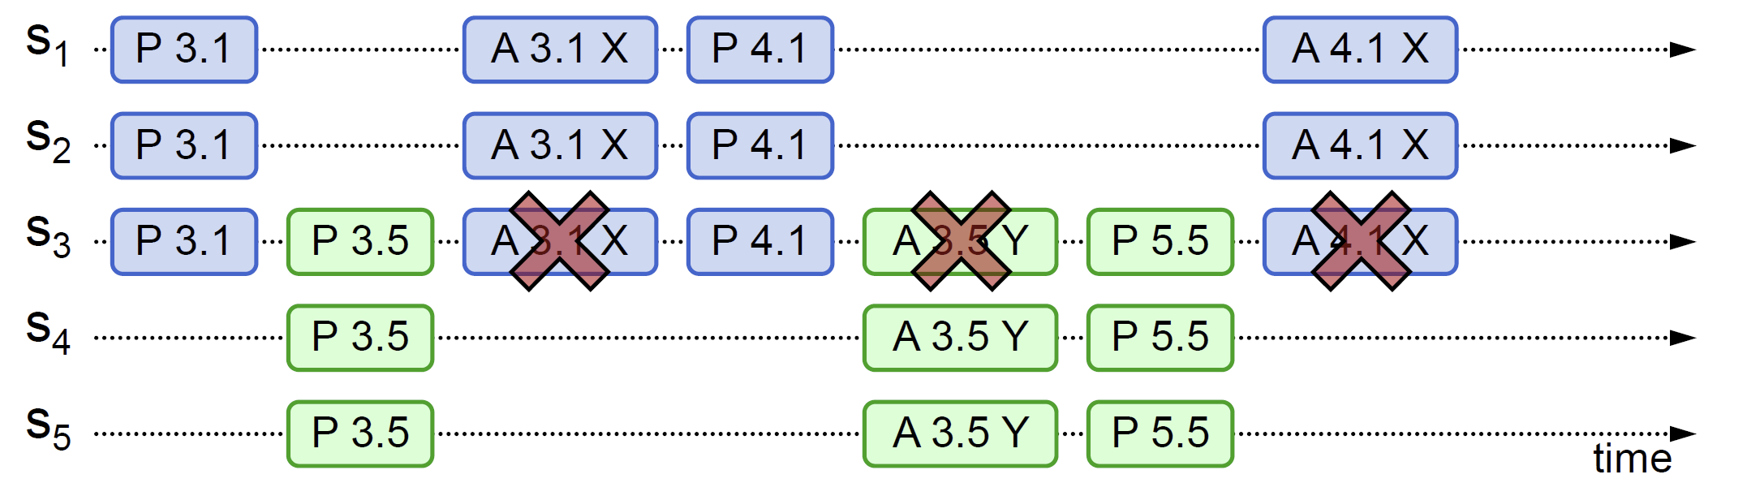
Example 4: Prepare (n)
A proposer chooses a new proposal number n and sends a request to each member of some set of acceptors.
S1 sends P 3.1 to S1, S2, and S3.
S5 sends P 3.5 to S5, S4, and S3.

Slide 30
Prepare (n) = ok/no, highest-numbered proposal and accepted value (if any)
If an acceptor receives a prepare request with number n greater than that of any prepare request to which it has already responded, then it responds to the request with a promise not to accept any more proposals numbered less than n and with the highest-numbered proposal (if any) that it has accepted.
S2 stores 3.1, returns ok, null, null to S1. S3 stores 3.1, returns ok, null, null to S1.
S4 stores 3.5, returns ok, null, null to S5. S3 stores 3.5, returns ok, null, null to S5.

Slide 31
Accept (n, v)
If the proposer receives a response to its prepare requests (numbered n) from a majority of acceptors, then it sends an accept request to each of those acceptors for a proposal numbered n with a value v, where v is the value of the highest-numbered proposal among the responses, or is any value if the responses reported no proposals.
S1 sends A 3.1 X to S1, S2, and S3.

Slide 32
Accept (n, v) = ok/no and highest proposal number
If an acceptor receives an accept request for a proposal numbered n, it accepts the proposal unless it has already responded to a prepare request having a number greater than n.
S3 returns no, 3.5 to S1 because 3.5 > 3.1.
S1 sends P 4.1 Y to S1, S2, and S3.
S5 sends A 3.5 Y to S3, S4, and S5. S3 returns no, 4.1 to S5 because 4.1 > 3.5.
S5 sends P 5.5 to S3, S4, and S5.
S1 sends A 4.1 X to S1, S2, and S3.
S3 returns no, 5.5 to S1 because 5.5 > 4.1.

Slide 33
Liveness
Competing proposers can livelock.
One solution: randomized delay before restarting
Give other proposers a chance to finish choosing
Multi-Paxos will use leader election instead.

Slide 35
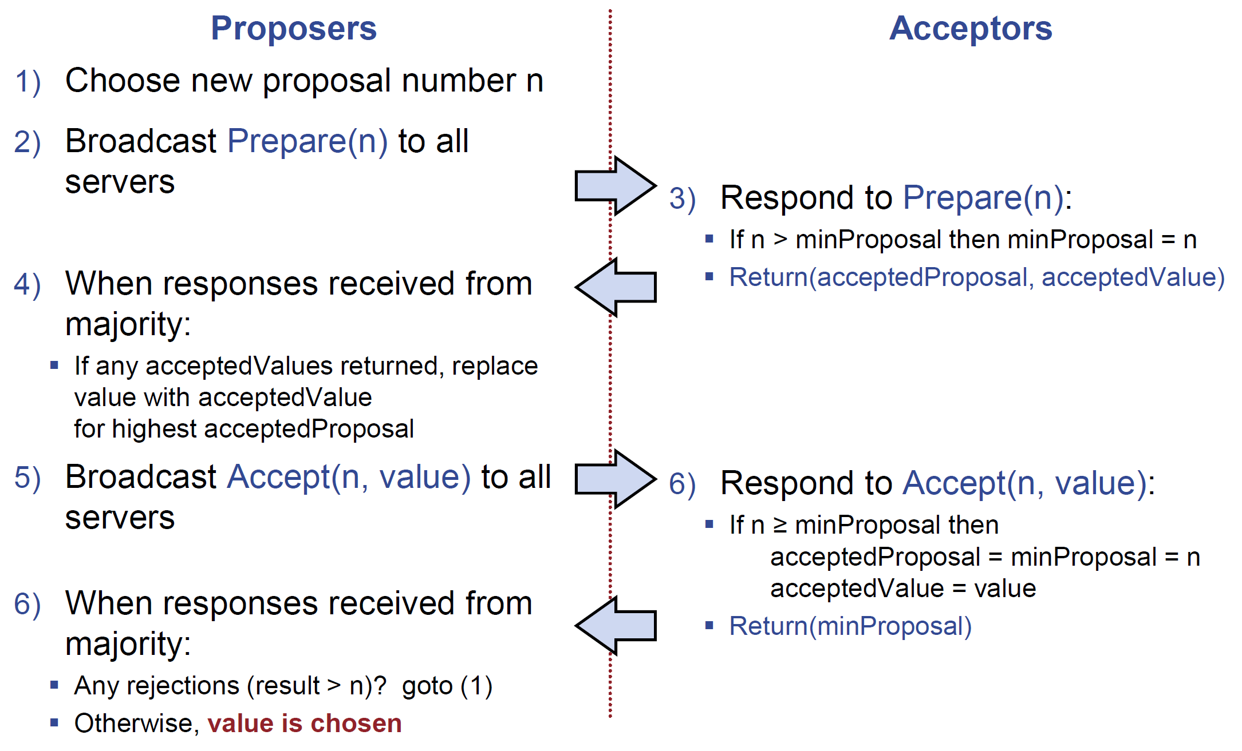
Basic Paxos Summary
Acceptors must store minProposal, acceptedProposal, and acceptedValue on disk.

Slide 36
Why Round Number Persistence?
Each server stores maxRound: the largest Round Number it has seen so far.
Proposers must persist maxRound on disk. Why?
Proposers must not reuse proposal numbers after crash/restart because this may lead to duplication.

Slide 37
Notes
Only proposer knows which value has been chosen.
If other servers want to know, must execute Paxos with their own proposal.
Paxos may be considered as 3-phase approach if a Commit phase is included to let all servers know that a value has been chosen.

Slide 39
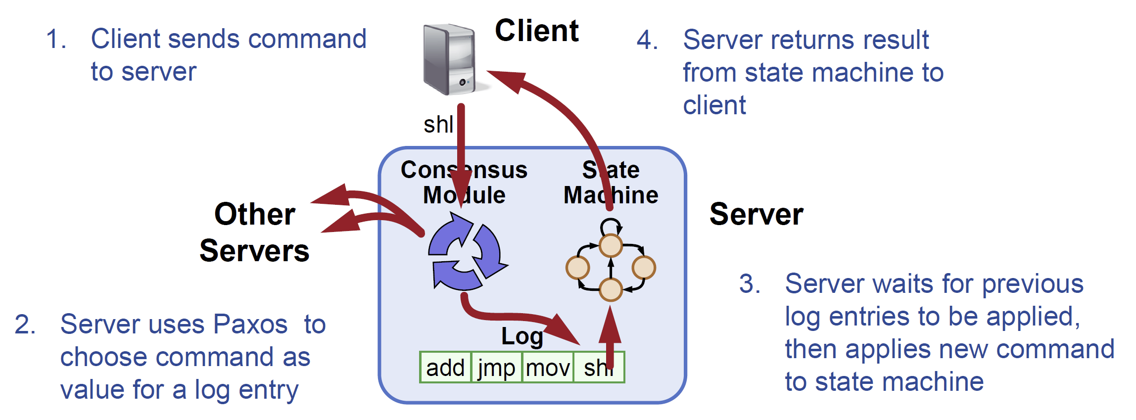
Multi Paxos
Note: Multi-Paxos not specified precisely in literature.
Key idea: Add log index parameter to each basic Paxos prepare and accept requests. Each log index has its own separate basic Paxos instance.

Slide 40
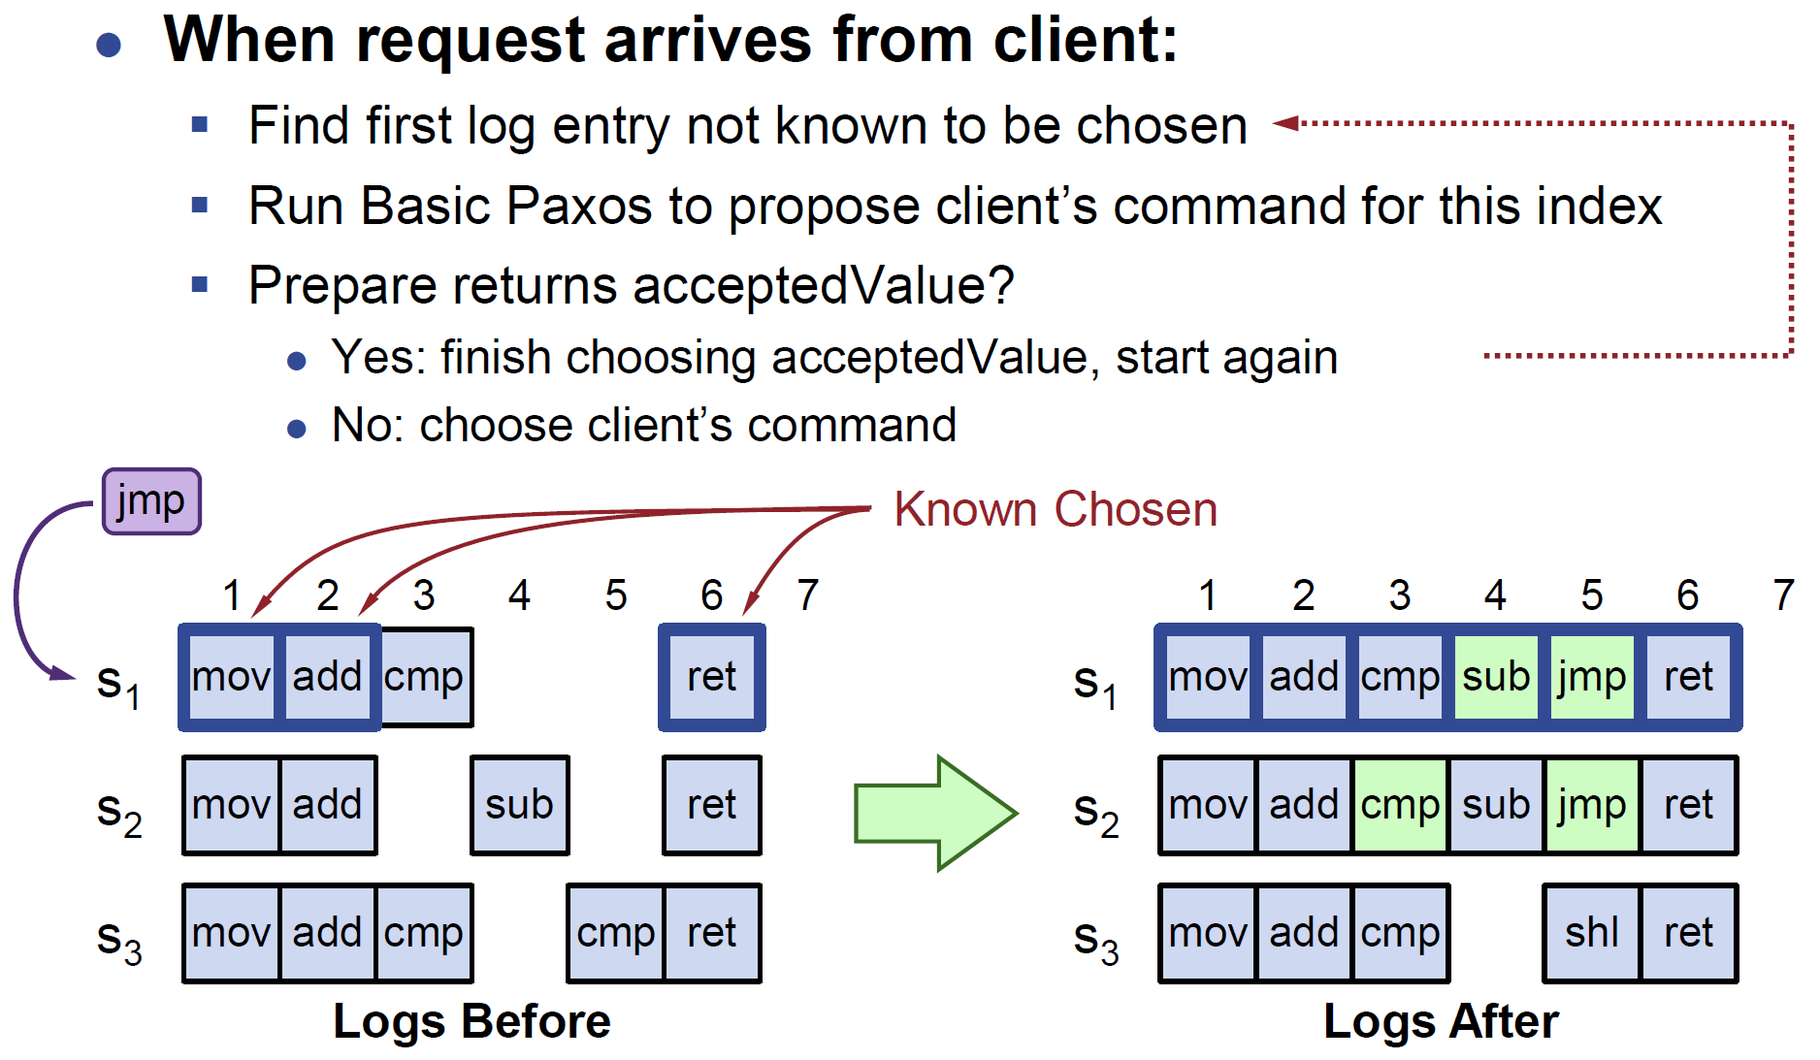
Selecting Log Index for a Client's Request
Key idea: Trial from the left to the right using Prepare.
Servers can handle multiple client requests concurrently: Select different log entries for each. Must apply commands to state machine in log order

Slide 41
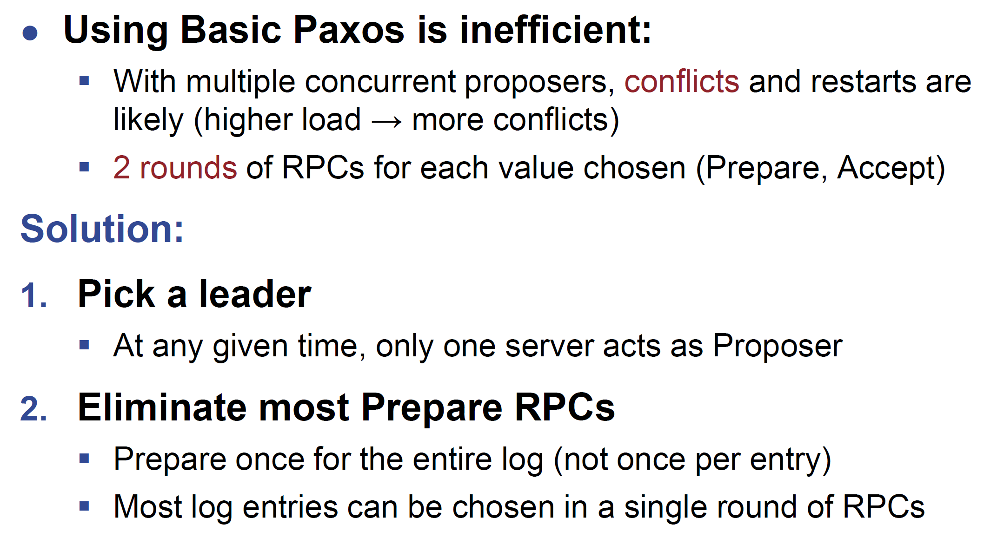
Improving Efficiency

Slide 42
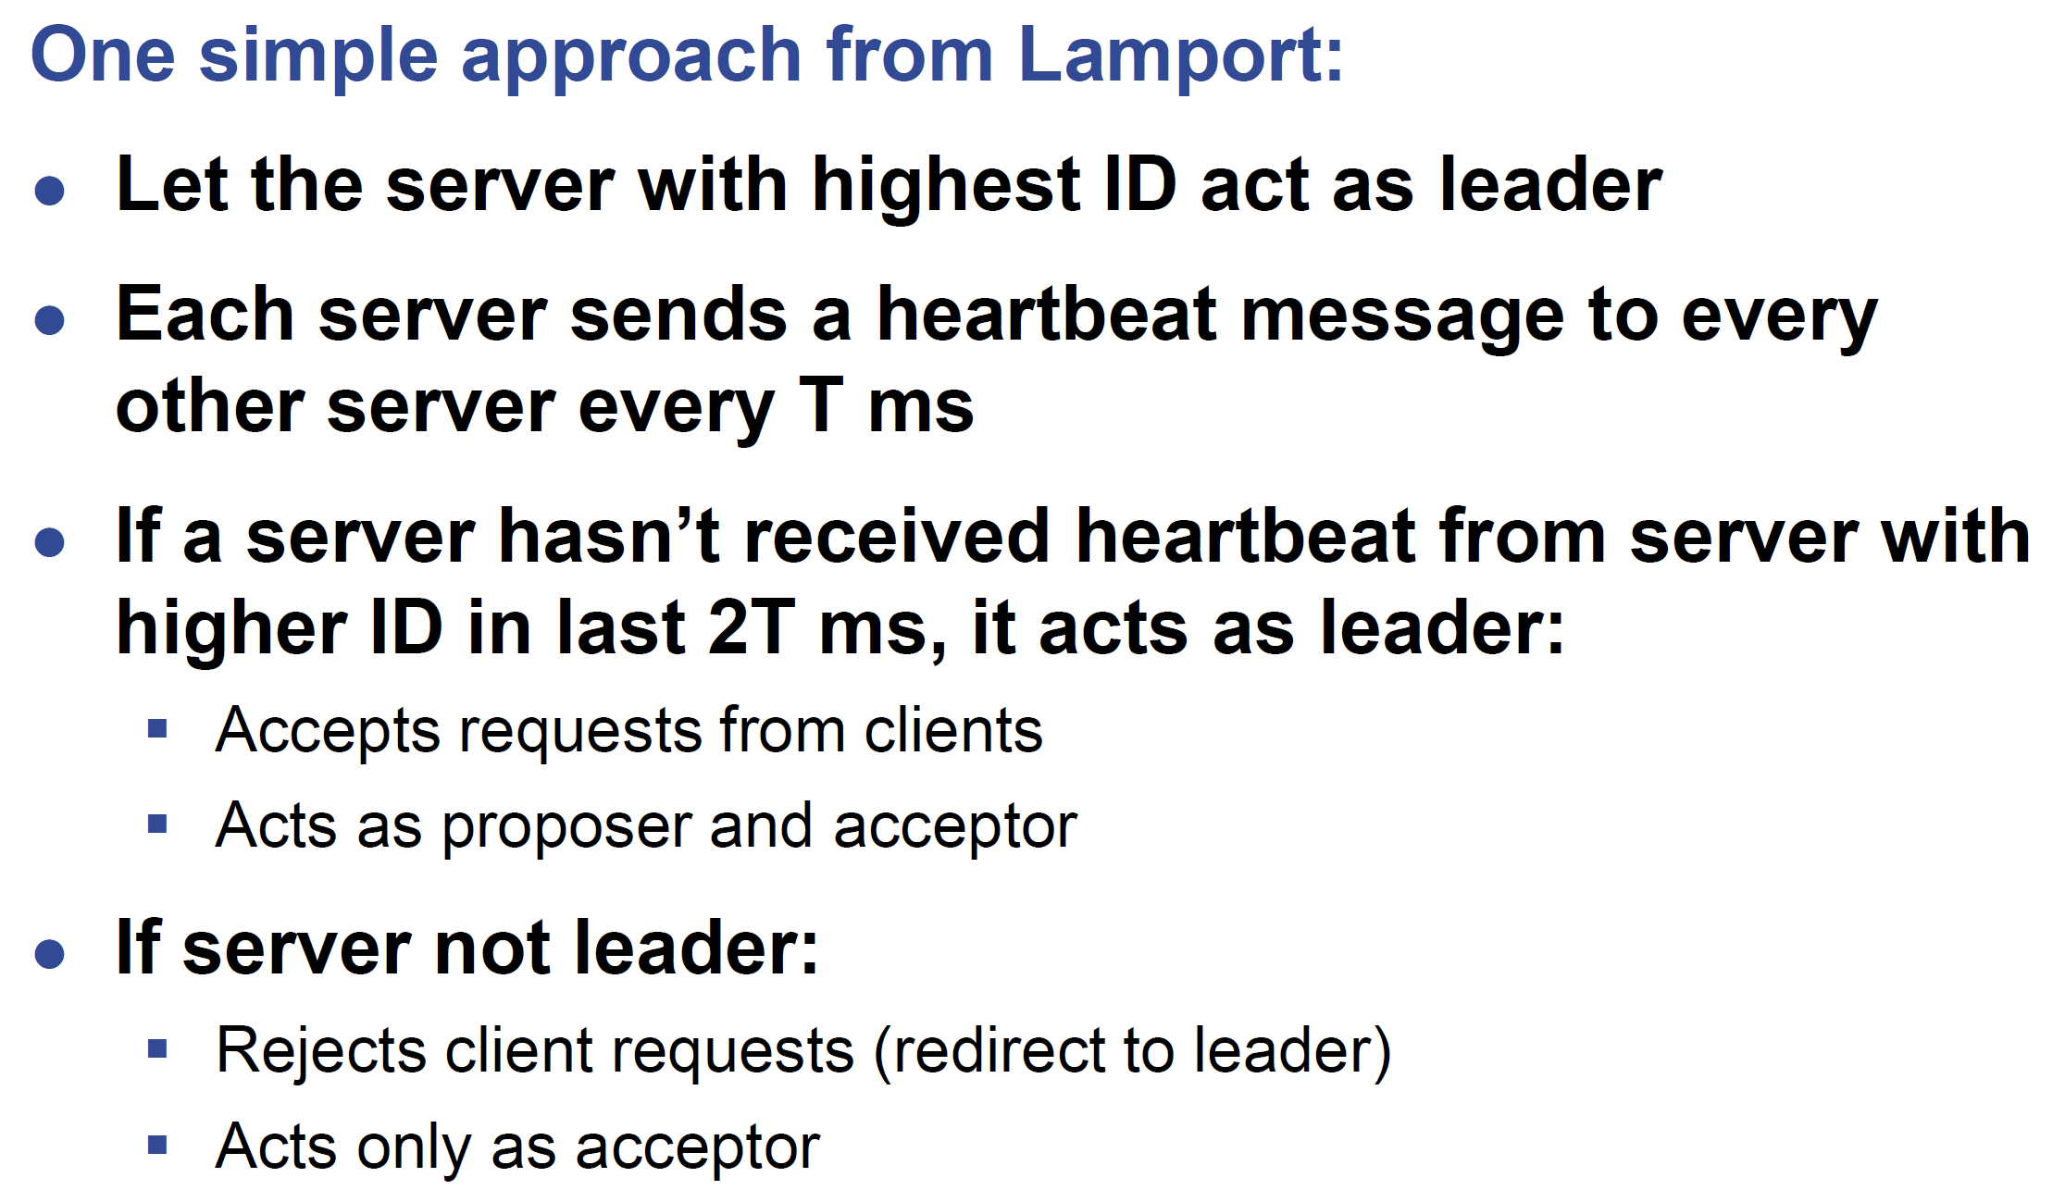
Leader Election

Slide 43
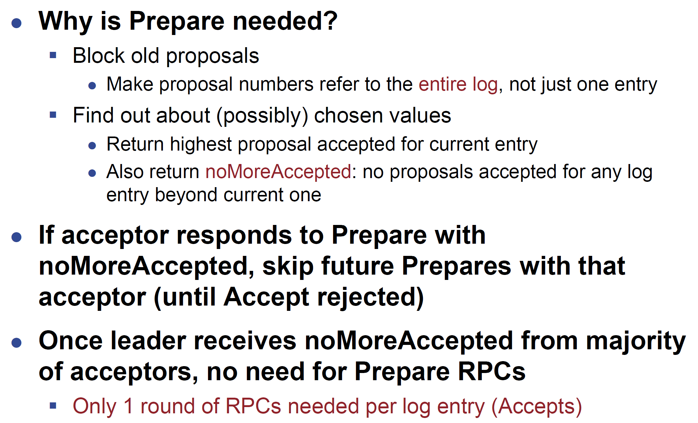
Eliminating Prepares

Slide 44

Thank You & See You Again

